Slide 1
Computer Science 1MD3 Introduction to Programming
Winter 2014
Michael Liut (liutm@mcmaster.ca)
Ming Quan Fu (fumq@mcmaster.ca)
Brandon Da Silva (dasilvbc@mcmaster.ca)

Slide 2
Contact Information
Feel free to email any of us! Please DESCRIBE YOUR QUESTION IN DETAIL WITH YOUR FULL NAME & STUDENT NUMBER.
We will reply to your email as soon as possible. You may not get a reply the day of the assignment due date or midterm .
Michael Liut (liutm@mcmaster.ca)
Brandon Da Silva (dasilvbc@mcmaster.ca)
Ming Quan Fu (fumq@mcmaster.ca)
Ming’s Personal Office: ITB 206
No Office hours, do you want to schedule a meeting with us?
Email us first to schedule a time. We do not have set office hours.
Drop-in Centre not run by TAs, but by Engineering Department.

Slide 3
Assignments
Assign_2:
Wed Feb 26/14 BY 11pm

Slide 4
MidTerm Test 1
Thu. Feb 13, 2014 16:30-17:20 T28
BEST OF TWO TERM TESTS (30%)
DO NOT MSAF!!!

Slide 5
Introduction
Programming Styles
Object Oriented Programming
Classes and Objects
Object Oriented Programming in Python
Examples

Slide 6
Programming Styles
Procedure-oriented: (Python, 1MD3)
Algorithms
Object-oriented: (Python,1MD3)
Classes and objects
Logic-oriented: (not included in 1MD3)
Goals, often expressed in a predicate calculus
Rule-oriented: (not included in 1MD3)
If-Then rules
Constraint-oriented: (not included in 1MD3)
Invariant relationships
*In this course we focus on procedure and object oriented programming.

Slide 7
Programming styles
Each of these styles of programming are based on their own conceptual framework.
Each requires a different mindset; it is a completely different way of thinking about and solving the problem at hand.

Slide 8
Understanding OO
Object-Oriented Programming (OOP) is a programming paradigm that represents concepts as "objects" that have data fields (attributes that describe the object) and associated procedures known as methods.
Objects, which are usually instances of classes, are used to interact with one another to design applications and computer programs.
C++, Objective-C, Smalltalk, Java, C#, Perl, Python, Ruby and PHP are examples of object-oriented programming languages.

Slide 9
Understanding OO
Lets use a real life example, something tangible:
We can think of a Car as one Class
With a type of car, for example a Jaguar, being its subclass
Or, think about a parent, and its child
Parent Class (Superclass)
Child Class (Subclass)

Slide 10
Classes and Objects
What is a Class? Why do we need them?
What is an Object? Why do we need them?
Do we need to know more about Classes and Objects?
Notes:
Class: a construct that is used to define a distinct type
Object: a location in memory having a value and referenced by an identifier.
Initialization of Objects:
Constructors ensure correct initialization of all data. They are automatically called at the time of object creation.
Destructors on the other hand ensure the de allocation of resources before an object dies or goes out of scope.

Slide 11
Understanding OO and Classes
For all things object-oriented, the conceptual framework is the object model. There are 4 major elements:
Abstraction
Encapsulation
Modularity
Hierarchy

Slide 12
Understanding Classes: Abstraction
Abstraction is one of the fundamental ways that we as humans cope with complexity. [1]
Abstraction arises from a recognition of similarities between certain objects, situations, or processes in the real world, and the decision to concentrate upon these similarities and to ignore for the time being the differences" [3].
An abstraction denotes the essential characteristics of an object that distinguish it from all other kinds of objects and thus provide crisply defined conceptual boundaries, relative to the perspective of the viewer. [1]

Slide 13
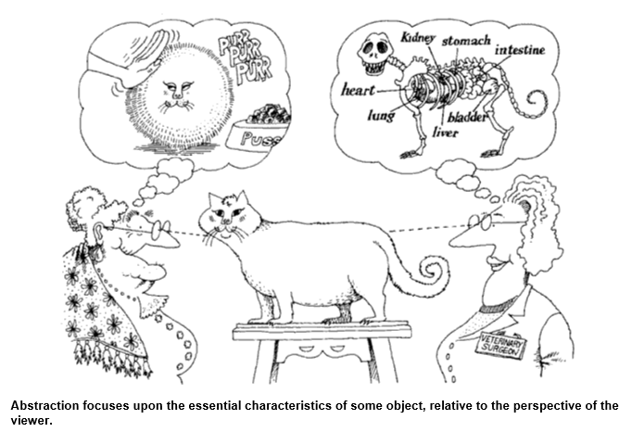
Understanding Classes: Abstraction

Slide 14
Understanding Classes: Abstraction
We can abstract different Classes and their relations from real project to form OO software design models
Input: Real project requirements
Output: Different classes
By: Abstraction

Slide 15
Understanding Classes: Encapsulation
Abstraction and encapsulation are complementary concepts.
Abstraction focuses upon the observable behavior of an object, whereas encapsulation focuses upon the implementation that gives rise to this behavior.
Encapsulation is most often achieved through information binding which is the process of hiding all the secrets of an object that do not contribute to its essential characteristics.

Slide 16
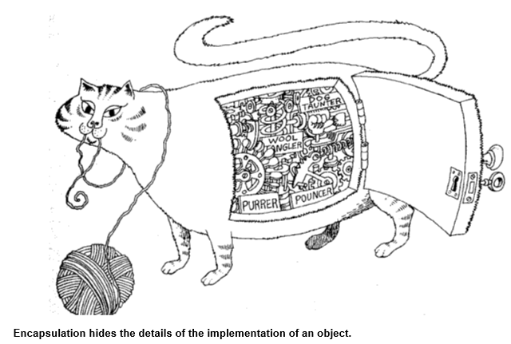
Understanding Classes: Encapsulation
www.michaelliut.ca/cs1md3

Slide 17
Understanding Classes: Encapsulation
In OO, typically, the structure of a class or an object is hidden.
The implementation of classes methods or object methods are hidden

Slide 18
Understanding Classes: Modularity
First, think about “toy bricks” – LEGO! ☺
The act of partitioning a program into individual components can reduce its complexity to some degree.[1]
Although partitioning a program is helpful for this reason, a more powerful justification for partitioning a program is that it creates a number of well defined, documented boundaries within the program. These boundaries, or interfaces, are invaluable in the comprehension of the program [4].

Slide 19
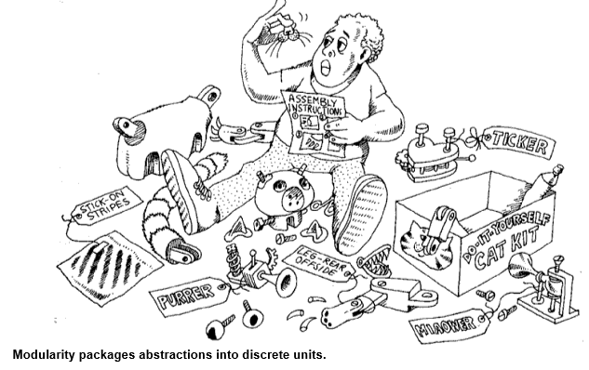
Understanding Classes: Modularity

Slide 20
Understanding Classes and Objects: Modularity
Modules serve as the physical containers in which we declare the classes and objects of our logical design.
For tiny problems, the developer might decide to declare every class and object in the same package.
For anything but the most trivial software, a better solution is to group logically related classes and objects in the same module, and expose only those elements that other modules absolutely must see.

Slide 21
Understanding Classes and Object: Hierarchy
Why do we need Hierarchy?
The Meaning of Hierarchy Abstraction is a good thing, but in all except the most trivial applications, we may find many more different abstractions than we can comprehend at one time.
Encapsulation helps manage this complexity by hiding the inside view of our abstractions.
Modularity helps also, by giving us a way to cluster logically related abstractions. Still, this is not enough.
Hierarchy is a ranking or ordering of abstractions.

Slide 22
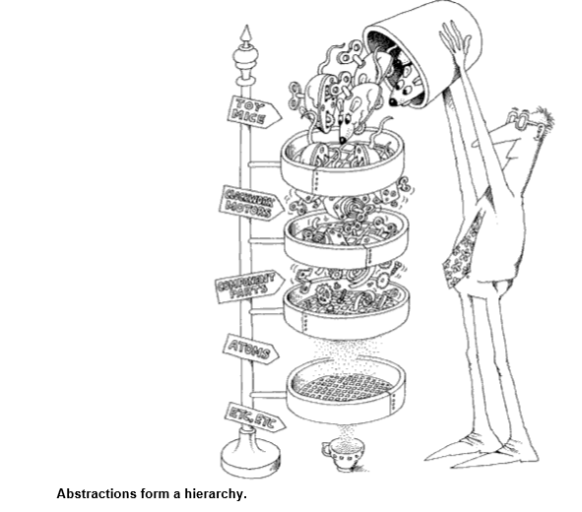
Understanding Classes and Object: Hierarchy

Slide 23
Overview of OOP Terminology
Class: A user-defined prototype for an object that defines a set of attributes that characterize any object of the class. The attributes are data members (class variables and instance variables) and methods, accessed via dot notation.
Class variable: A variable that is shared by all instances of a class. Class variables are defined within a class but outside any of the class's methods. Class variables aren't used as frequently as instance variables are.
Data member: A class variable or instance variable that holds data associated with a class and its objects.
Instance variable: A variable that is defined inside a method and belongs only to the current instance of a class.

Slide 24
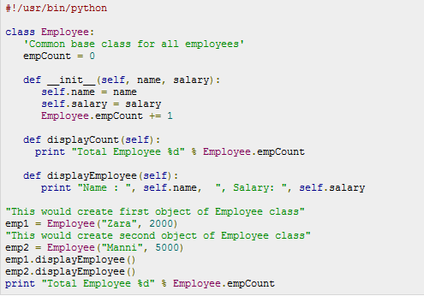
OO Examples in Python

Slide 25
References
[1] Book, OBJECT-ORIENTED ANALYSIS AND DESIGN
Grady Booch, Second Edition, ISBN 0-8053-5340-2,1998
Images are also referenced from this book.
[2] http://en.wikipedia.org/wiki/Computer_program
[3] Keene. Object~Oriented Programming, p. 118.
[4] Lea, D. Aug.st 12, 1988. Users Guide to GIVV C++ Library. Cambridge, MA: Free Software Foundation, p. 12
[5] http://www.tutorialspoint.com/python/

